Slide 1
SQE assessment methodology: assessing day one competence
Dr Eileen Fry, Director of Assessment, Kaplan
Dr Lee Coombes, Director of Psychometrics and Assessment Development, Kaplan

Slide 2
Assessing day one competence
Current Good Assessment Practice: Fundamental Psychometric Principles
Marking and competency-based exams
Setting standards: ‘cut scores’ and pass marks

Slide 3
Fundamental psychometric principles
High stakes exams which lead to admission into a profession have to fulfil fundamentally different criteria from eg university exams
To provide a technically competent licensing exam, which tests people appropriately and fairly, you need:
    Reliability
    Precision
    Validity

Slide 4
Fundamental psychometric principles
Reliability
Numerical – to do with consistency and predictive utility. Does the test rank order candidates in a way that would be replicated in another exam? Measured most simply by the alpha co-efficient
Precision
Numerical– statistically related to reliability. How accurate is any candidate’s score? Estimated by the Standard Error of Measurement (SEm)
Validity
A unifying framework for a “good test”: testing the right things in appropriate ways; includes reliability and precision

Slide 5
Why?
“I was lucky what I had revised came up” should have no place in a high stakes professional exam
In a high stakes professional exam whether or not candidates qualify must be based on an assessment of appropriate competencies and knowledge which would be replicated if they took a similar exam and which reaches a very high standard of accuracy
Responsibility to the consumer
Responsibility to the profession
Responsibility to the candidates
The exam must be defensible in the courts

Slide 6
Reliability: how it is measured
Reliability: Does the test rank order candidates in a way that would be replicated in another exam?
Ideally, measured by candidates taking two exams
Alternative: divide the test into two parts, as many ways as possible; compare performance on the halves
Coefficient alpha averages the result of dividing the test into all possible halves and comparing performance (the correlation) on the halves
⍺ ranges from zero to one
Best practice targets are at least 0.8 for an OSCE; at least 0.9 for an MCQ. This is because high stakes professional exams have to get it right

Slide 7
What does this mean for exam design?
If you ask one question on contract, you will have little idea of whether a candidate will get the next question right
If you ask more questions, the predictive power of the result will increase.
Longer tests (unless there is something very wrong with them) are more reliable than shorter tests.
But test design is a compromise– a much longer exam will also be more expensive

Slide 8
Longer tests are more reliable (= alpha is bigger)
Example is SQE Pilot MCQ
Best practice target MCQ minimum is 0.9
⍺

Slide 9
What is precision?
All measurement has some error
There is difference between a candidate’s actual score on the test and their true score which would result from their taking an infinite number of similar tests
We know their actual score but can clearly never know their true score. We can estimate its value statistically, within a range using the Standard Error of Measurement (SEm)

Slide 10

An illustration of SEm: A mark of 51% might be very precise, say very probably between 50% and 52%
45%
50%
51%
55%
60%

Slide 11
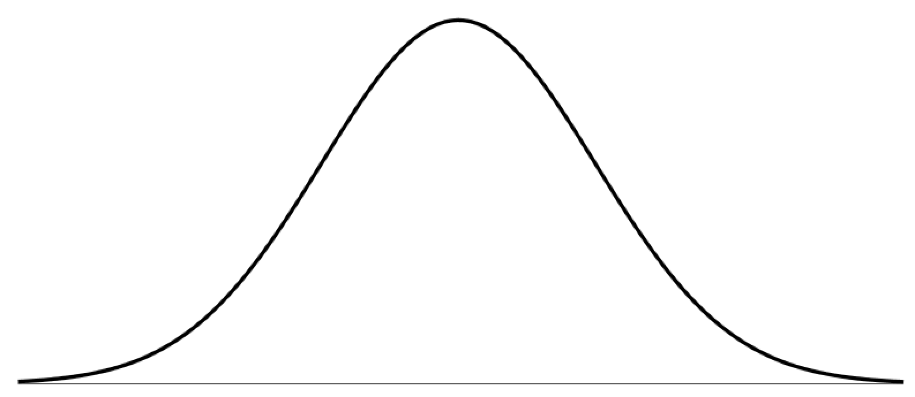
Another illustration: A mark of 51% might be quite inaccurate, say very probably between 46% and 56%
51%
45% 50% 55% 60%

Slide 12
The Standard Error of Measurement SEm
SEm (Precision) depends upon:
  Test length
  Test reliability (⍺)
  The spread of candidates’ scores
The lower the SEm the higher the quality of the exam

Slide 13
Test precision – standard error of measurement (the SEm) – decreases as test length increases
Example is SQE Pilot MCQ
SEm

Slide 14
What does this mean for exam design?
Unless there is something very wrong with the test candidates’ scores are more precise from longer tests
But test design is a compromise and this must be balanced with competing factors such as cost

Slide 15
Validity
Kane Validity Framework: 5 key domains of validity evidence:
  Assessment content (appropriate content, sufficient sampling etc)
  Assessment response process (marking, quality control etc)
  Internal structure of the assessment (reliability, precision, standard setting etc)
  Relationship to other variables (performance on other tests – statistical concurrent validity etc)
  Consequences of the assessment outcome – (for all stakeholders - reasonableness and reliability of pass/fail determination, appeal procedures etc)
For further information, see the Kane Validity Framework. Eg Kane, MT (2013) Validating the Interpretations and Uses of Test Scores. Journal of Educational Measurement, 50(1), 1-73

Slide 16
Reflections on marking

Slide 17
Exercise: working individually as examiners, please give this student a mark out of 10
Answer:
269
x 63
807
16040
16847
The student’s task:
“Multiply 269 by 63”

Slide 18
Marking legal skills stations
Some issues:
The results and the approach
A small mistake that could result in a negligence claim given the fact pattern and vice versa
In looking at the detail the examiners may miss the whole:
    The scattergun approach
    The answer which makes the right points but lacks understanding
Mark schemes that require examiners to exercise professional judgment have greater validity for entry to a profession provided there is a level descriptor and examiners have adequate training, preparation and monitoring

Slide 19
Competency based marking of legal skills assessments in the SQE
Marking is based on the professional judgement of examiners informed by competency as defined by the level descriptor (the Threshold standard) and the Functioning Legal Knowledge
This will involving grading performance against the assessment criteria in terms of the required level of competency. Typically this might involve grading as follows:
    Superior performance: well above the competency requirements of the assessment (5 marks)
    Clearly satisfactory: clearly meets the competency requirements of the assessment (4 marks)
    Marginal pass: on balance, just meets the competency requirements of the assessment (3 marks)
    Marginal fail: on balance, just fails to meet the competency requirements of the assessment (2 marks)
    Clearly unsatisfactory: clearly does not meet the competency requirements of the assessment (1 mark)
    Poor performance: well below the competency requirements of the assessment (0 marks)
This approach ensures the connection is maintained between marking and the purpose of the assessment and so helps maintain its Validity

Slide 20
Setting the pass mark for the SQE: cut scores and pass marks

Slide 21
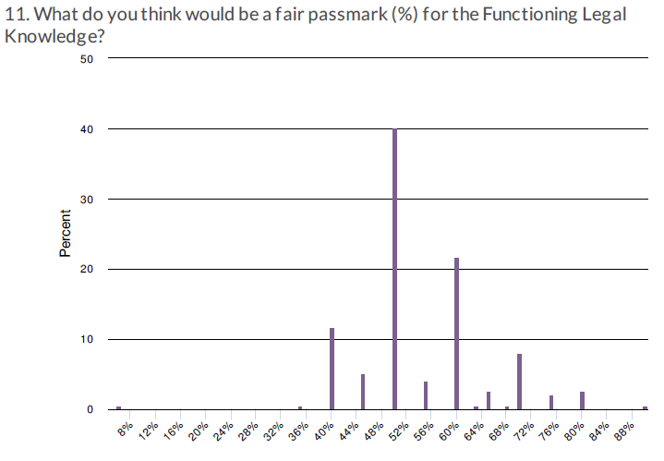
What should the pass mark for the SQE be?
The traditional approach
Choose an appropriate mark
SQE1 Pilot:

Slide 22
Why can’t we use the traditional approach
What pass mark should we choose and how can we justify our approach?
40%? 50%? 60%?
The exam might be more difficult or easier than usual
Fairness to candidates
Protecting the consumer
Maintaining the standards of the profession
Anticipated legal challenges

Slide 23
What is the alternative?
Don’t start from a number and apply it to the script
Start from a description of the just passing candidate – a level descriptor – and apply it to the exam
The pass mark is based on the professional judgement of the examiners about the application of the level descriptor ( the threshold standard) to that particular assessment
Results in a justifiable pass mark which adjusts to the difficulty of the exam and maintains standards between cohorts even if the ability of cohorts is different

Slide 24
How is the level descriptor applied to the exam?
Angoff method for objective testing (e.g.MCQs)
  A panel of solicitor ‘judges’ assesses individual test items and estimates the performance of a ‘just passing candidate’ on each
Borderline regression (for legal skills stations)
  In addition to providing detailed marks on the candidate’s OSCE station performance, the examiner gives a global estimate of outcome on the station (eg Clear Pass). The latter is used to set a cut score on the former
Accommodating test unreliability
  Modifying the cut score to a pass mark
Triangulating’ – when more than one method is used

Slide 25
Angoff method
(for objective testing including MCQs)
Standard setting group of 10 – 16 ‘judges’ = solicitors
All qualified solicitors, should include some newly qualified
NOT people with unrealistic expectations
Use of level descriptor of the just passing candidate to discuss characteristics of a candidate who will just pass
Each panel member assesses the likely performance of 10 just passing candidates on each of the questions: how many would get it right?
The average rating of the panel members becomes the difficulty rating of each question
The item difficulty ratings are then averaged over all questions to calculate the borderline cut score

Slide 26
Completed spreadsheet from 15 judges
If the range for any item is large or if there are outliers, discuss reasons and possibly re-score
Mean estimate for each item is summed to get borderline cut score for exam (red)

Slide 27
Borderline Regression
(for legal skills stations)
Stations (individual assessments) are the building block for calculating test reliability and setting the passing standard
In addition to providing detailed marks on the candidate’s performance on each assessment (station), the examiner gives a global estimate of whether or not the candidate reaches the standard of a newly qualified solicitor of England and Wales (Pass, Marginal Pass, Marginal Fail, Fail)
A statistical calculation reviewing all candidate marks in the light of all global judgements will set the cut score on each station

Slide 28
… for one candidate on one station

Slide 29
… now, for all candidates on one station

Slide 30
Insert a ‘line of best fit’

Slide 31
Set ‘borderline’ as midway between MF & MP

Slide 32
‘Borderline station score’ is at the intersection
→

Slide 33
Calculating the cut score for the exam
Averaging all the station borderline scores will give the cut score for the whole exam

Slide 34
From cut score to pass mark
The Angoff method can be used to set the cut score for objective testing (eg MCQs) and borderline regression for legal skills stations
But this takes no account of precision – the standard error of measurement
Candidates’ true score (on an infinite number of tests) may be higher or lower than their actual score on this test
In high stakes professional exams the interests of the consumer are normally considered paramount and so an allowance for measurement error is added on to the cut score to arrive at the pass mark

Slide 35

‘Triangulating’
Often, more than one method of standard-setting is used for a test
In this case, the strengths and level of each can be reviewed by the Exam Board and some compromise agreed

Slide 36
End
Thank you for your attention
eileen.fry@kaplan.co.uk

