Slide 1
Regulatory reform: what you need to know
Chair: Clive Myrie
Paul Philip, Chief Executive, SRA
Juliet Oliver, General Counsel, SRA
Jane Malcolm, Executive Director, SRA
Julie Brannan, Director of Education and Training, SRA

Slide 2
Our Standards and Regulations
Juliet Oliver, General Counsel, SRA

Slide 3
Our reforms
Focus on standards, but without prescription
Getting rid of unnecessary bureaucracy
Short, user-friendly
Greater freedom about where and how solicitors can practise
Notes:
As Paul has talked through, our reforms are about:
A sharp focus on high standards, while getting rid of lots of prescription
Getting rid of unnecessary bureaucracy that only adds costs onto firms – with a good chance this is then passed onto clients
Making our rules shorter and much easier to navigate
Giving you greater freedom about where and how you can work

Slide 4
SRA Standards and Regulations
+
New codes of conduct for individuals and firms
Simplified
Accounts
Rules
New
practising flexibility
Revised
principles
Enforcement
Strategy
Notes:
I am going to do a quick run through five key areas of change:
The revised principles
The new codes
The simplified accounts rules
The new practising flexibility
And our updated enforcement strategy

Slide 5
Principles
Apply to all solicitors
Ten principles down to seven
Honesty and integrity separate
Notes:
Principles
The Principles are fundamentally about ethics - how we expect everyone we regulate to act.
If in doubt about what you should do in a given situation, the Principles are the right place to start.
Although there have not been any major changes to our principles we have reduced the number down from ten to seven.
In the interests of making it simpler, we got rid of some of the principles that we think better sit with in the codes.
For instance, we felt the principle around dealing with your regulator and the ombudsmen in an open, timely co-operative manner better sat in the codes.
There is still a principle around acting in the best interests of clients. But we did not feel we also needed a principle around providing a proper standard of service to your client. Again that could be covered in the codes.
It does not mean they don’t need to be met.
Integrity vs dishonesty
Finally honesty has been introduced as a principle.
Integrity is a separate principle. And we often get queries about what integrity means, and how that might differ from dishonesty.
Dishonesty is a base standard. The concept of integrity is wider and relates to professional standards that impose a higher obligation – acting without integrity could involve taking unfair advantage of clients, wilfully or reckless disregard rules, or allowing a third party to be misled.
As part of the new Standards and Regs we have published guidance on acting with integrity to help aid understanding of what this principle means. I’d encourage you to look at it.

Slide 6
Codes
Code for individuals:
applies to all solicitors, whoever they are and wherever they work
Code for firms:
Sets out standards and business controls expected of firms
No indicative behaviours
Notes:
The first big change is that we now have two codes: one for solicitors and one for firms.
We think that will make things clearer, particularly for individual solicitors with one short, easy code that applies to them: whoever they are and wherever they work.
About a quarter of those we regulate work in-house. Yet we were finding that many in-house solicitors weren’t engaging with our codes, because they thought they were an issue for firms.
On top of that some solicitors within firms were not engaging with the codes - as they took the view that compliance was an issue for the compliance team.
Though a simple, short individual code, we want to put that misconception right. Clearly set out the standards of professionalism expected of individuals.
Everyone in your firm – particularly solicitors – need to understand it.
The role of compliance officers and the standards and business controls expected of firms that will be relevant for compliance officers are in the firm code.
Getting rid of the indicative behaviours
The codes in our current Handbook have a lot of non-mandatory indicative behaviours.
These offer examples of how you might comply with the outcomes set out in the codes.
Even though these were not mandatory, they were often treated as such. The result? Well people viewing it as lots and lots of detailed rules, micro-managing the way you work.
So we have stripped these out - there are no indicative behaviours in there.
That means the code is simpler; it is putting trust in your professional judgement to assess the right call on the details of specific cases.
Does that mean we have totally got rid of guidance or helpful examples or case studies?
No - we have published a range of guidance, including case studies. It’s not new rules though the backdoor. It’s not overly prescriptive. Instead it offers support and guidance – in particular to help people through grey areas, such as what integrity means or the nuances around conflicts of interest.
The guidance is also there to help people understand areas of particular significant change, such as the account rules.

Slide 7
Enforcement Strategy
Clarity for the public and the profession
Why and when we will take action
Mitigating and aggravating factors
Enforcement in practice guides
Notes:
Enforcement strategy
Quite often we hear the concern: with such flexibility - but with fewer prescriptive rules - how do I know you are not just going to try and catch me out? Are you giving yourself carte blanche to take action against me…
We are putting more trust in your professional judgement, informed by the principles and codes.
We are not trying to second guess the way you choose to comply in every given situation.
That will mean - particularly if you think you are making a judgement that is not clear cut - that you will want to be clear in noting how and why you made your decision.
And if you are unsure, beyond the codes and principles, you should look at our enforcement strategy. That underpins all our rules and regulations
It aims to provide clarity on what we see as serious; and why and when we would take action.
We developed on the back of our Question of Trust campaign, which sought the views of around five-and-a-half-thousand members of the public and the profession.
In our enforcement strategy we set out some of the factors that might affect our view of the seriousness of the breach, such as the harm caused by the solicitors actions, the vulnerability of the clients, the seniority and experience of the individual and whether this seems to be part of a pattern of behaviour.
What does that look like in practice? Well we have produced some guides to certain issues to talk through our approach, and the mitigating and aggravating factors we’d take into account.
Issues covered include issues we regularly deal with like drink driving, offensive communications and using social media, and competence and standards of service.
I’d like to reassure you that we generally would not be taken serious enforcement action where a genuine mistake has been made. And mitigations are in place – for instance if it is not a repeated pattern of behaviour, the solicitor has been clear and up front with the client about the mistake and aimed to put it right – if appropriate – or alternatively said that the individual would need to seek independent legal advice.
In such instance, we are far more likely to engage and support the firm than seek serious sanctions.

Slide 8
New Accounts Rules
Reduced prescription
Clearer, sharper rules that set standards we expect
Core protections remain – focus on keeping client money safe
Notes:
Paul has already touched u on the new account rules and they are being covered in detail in breakout sessions, so I will keep this very brief.
By removing prescription and focusing on what matters – keeping client money safe – we have reduced the account rules from more than 40 pages to less than 10.
To give an example of the type of rules we have got rid of, we had strict time limits for dealing with monies.
Firms had 48 hours to deal and transfer any money for their fees or professional disbursements.
And 14 days to transfer out office money legitimately held in client account
We think this was onerous. We heard about experiences - particularly in more rural areas – of people having to make regular and long trips to pay in a cheque to the bank in time.
So we have replaced this with a rule that says firms need to deal with this money promptly. This is an area where we think it is right to put more trust in your professional judgement, and give you flexibility to run your business effectively.
Yet core protections still remain in place where they are vital to protect client money:
Firms still need to return client money, as soon as they have no need to keep it
Client accounts should never be used as a banking facility
We still expect firms to carry out good record keeping and reconcile their accounts every five weeks. They should promptly deal with any differences that emerge.

Slide 9
Practising flexibility
Solicitors able to offer reserved services to the public as “freelancers”
Solicitors able to offer non-reserved legal services to the public in an non-regulated organisation
Notes:
Paul has talked through the logic of why we think giving you more freedom as to where you work is the right thing to do.
Yet we recognise there are risks in doing this. So we have put in place a range of protections to help manage these risks…
So if you want to provide reserved legal services to the public as a freelancer, this can only be done if you are genuinely working on your own. This means
Having no employees or partners
Not doing it through a service company
And having being directly engaged personally by the client
In addition to that
You will not be able to hold client money other than for fees and disbursements ahead of a bill being delivered
You will have to have adequate and appropriate insurance
You must have been practising for three years
In terms of offering unreserved services in an unregulated organisation – that could be anything from an accountancy firm to a travel agent; a HR firm to an architectural practice.
As you can only provided non-reserved legal services there are fewer restrictions in place. You won’t be able to handle client money doing such work.
But more broadly – wherever you work you will subject to our codes and rules – and solicitors working in this way will need to be totally up front with potential clients about the protections they have – and don’t have compared to a regulated law firm.
Again we have published a range of new guidance to help people understand what you need to do if you want to work in this way.

Slide 10
Preparing for 25 November
Cultural shift, less prescription
Reviewing systems and processes
Enforcement Strategy and
reporting
Clickable logo on website
Staff understand changes
Notes:
As Paul said, we think these changes are more about an opportunity to work differently rather than forcing you to make lots of change.
However, there are five things I’d recommend you do to prepare for the 25 November:
Have a think about what an approach of less prescription means for you and your firm. Allow you greater flexibility, but need to make sure you are being clear about how and why you are making decisions
You should also make sure you understand the reporting obligations as set out in our codes and enforcement strategy. Every solicitor has a responsibility to report potential misconduct to us promptly - that means you shouldn’t wait to the very end of completing an internal investigation if you suspect earlier on that there may have been a serious breach.
Does your firm documentation - and systems and processes - reflect the new Standards and Regulations. There might be opportunities to do things differently - most obviously perhaps with the new accounts rules.
Does everyone in your firm understand the changes - everyone should at least be familiar with the principles and individual code.
Does your website display our clickable logo? Jane will share a bit more detail on this in a moment, but the logo becomes mandatory for all firms from 25 November.

Slide 11
Guidance and support
One stop shop
sra.org.uk/
newregs
Online Standards and Regulations
beta.sra.org.uk
Professional Ethics helpline
Notes:
That is a quick run through of some of the key changes.
But we have published a range of support to help you comply.
Firstly we have launched a one-stop shop webpage – the web address is on the slide – which has a whole package of support in one place – not only links to guidance but also webinars, videos and graphics
Secondly, we have worked with more than 2,000 solicitors to help develop an easy to use, up to date version of the new rules. It’s not just the Standards and Regulations themselves, but there are links to appropriate context such as guidance and a glossary as well.
Thirdly, if ever you’re not sure about something – phone our Ethics Guidance helpline who can offer you support.
Now for Jane to say a few words about better information for the public

Slide 12
Better information
Jane Malcolm, Executive Director,
External and Corporate Affairs, SRA

Slide 13
Better information: the problem
Competition and Markets Authority – lack of information a problem for public and small businesses
People want to shop around – but only 1/5 firms were publishing price information
Not just price – want range of information to inform choices
Firms will do:
£
Notes:
CMA concluded in the 2016 that the legal sector was not working that well for the public or small businesses. One of the key problems it identified was a lack of information to help people navigate the market and make informed choices.
People want to shop around. And price is an absolutely key thing people want to know about. However, with only 1 in 5 firms publishing prices.
Price is important – but it is not all people are interested. Quality and reputation are the other key factors.

Slide 14
Better information: our approach
Us
Firms will do:
Solicitors Register
SRA clickable logo
Firms - from December 2018
£
Price and description of services
How to complain
(including to LeO)
Notes:
We responded by suggesting a package of reforms. Some putting the onus on to take action – such as creating a Solicitors Register and clickable logo.
And others asking firms to make changes: publishing info about price and service seven common areas, such as conveyancing and uncontested probate. And also to provide straightforward info about how to complain

Slide 15
Clickable logo
Help verify your firm is regulated, promote protections
4 in 10 firms already using
Mandatory from 25 November
Notes:
Been able to use since November last year
Around 4 out of 10 firms are already using. Good opportunity to promote the extra protections you get from using a regulated law firm.
All firms with a website must use it by 25 November. Come to our website to find out more. But recommend if you are confused in any way, speak to the teams on our stands who will be able to help.

Slide 16
The Solicitors Register
Online register of everyone we regulate
Data drawn from mySRA
Validation tool - no commercial element
Further development later 2019/2020
Notes:
Currently have two look-up tools.
Check a solicitors record and Law firm search. The new Register will eventually replace theseWe are looking to consolidate our current register products into one.
This is not just about better information for the public.
Our research with the profession has identified that our current tools are frequently used (to check the other side and for recruitment purposes)
We also know that other institutions use the tools – such as banks
Want to make life easier for you, checking people on the other side

Slide 17
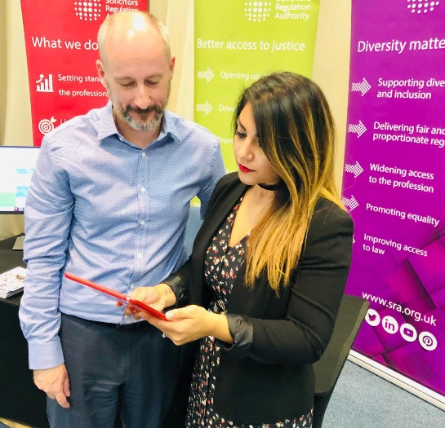
Developing the Solicitors Register
Developed with 2000+ users
Public YouGov surveys
Ongoing input from the profession, including Evolve group
Notes:
Developed the new Solicitors Register working extensively with both the profession and the public.
That includes through surveys, 1 to 1 users sessions, focus groups and using our Evolve group, which is made up of around 1,500 solicitors from lots of different types of firms.
It is important that the Solicitors Register responds to users needs in its design.

Slide 18
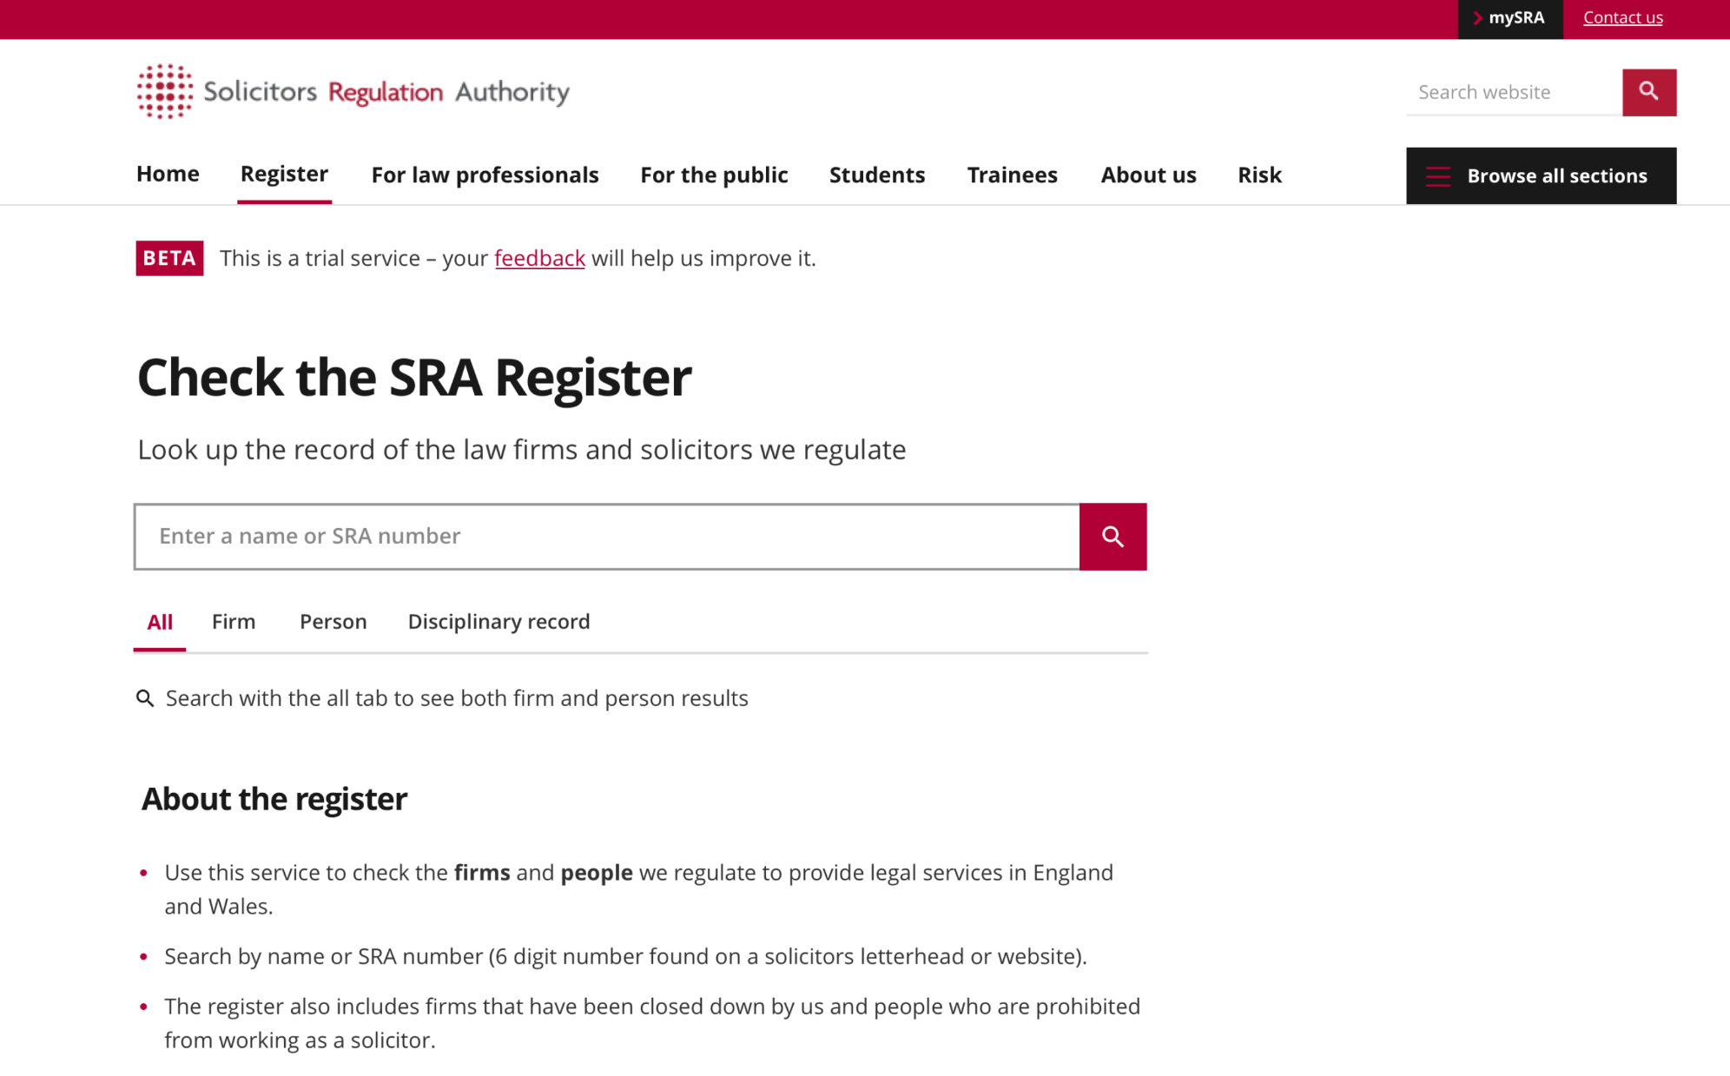

Slide 19
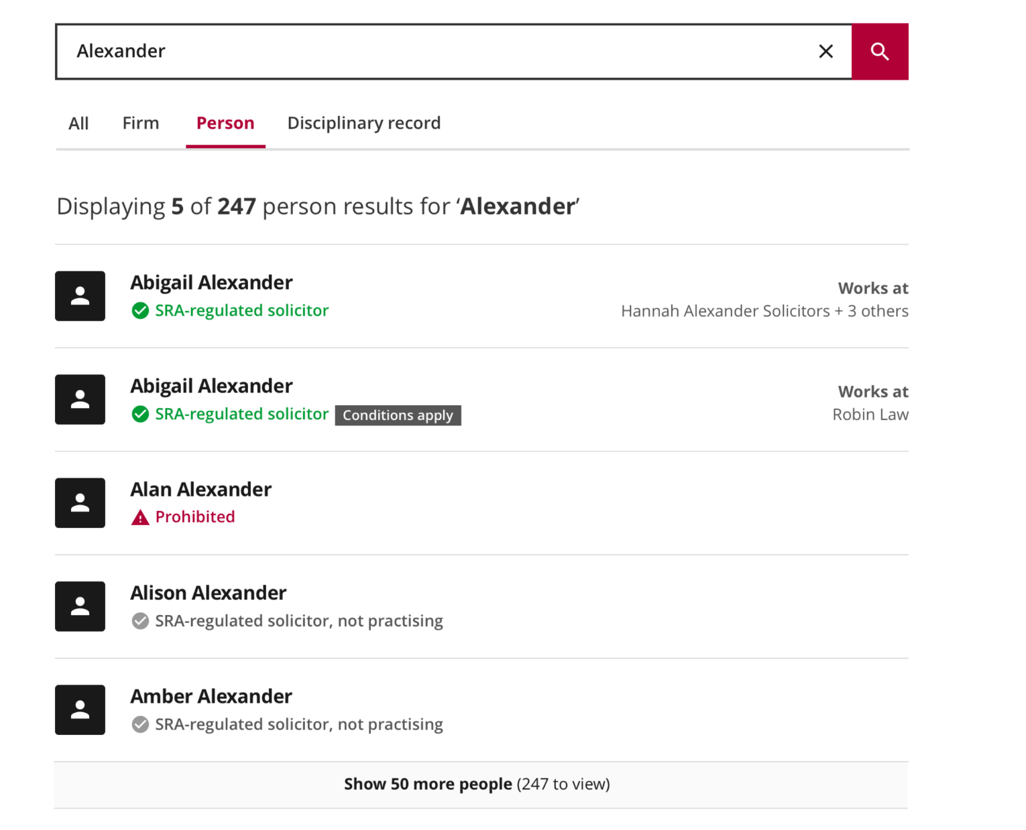

Slide 20
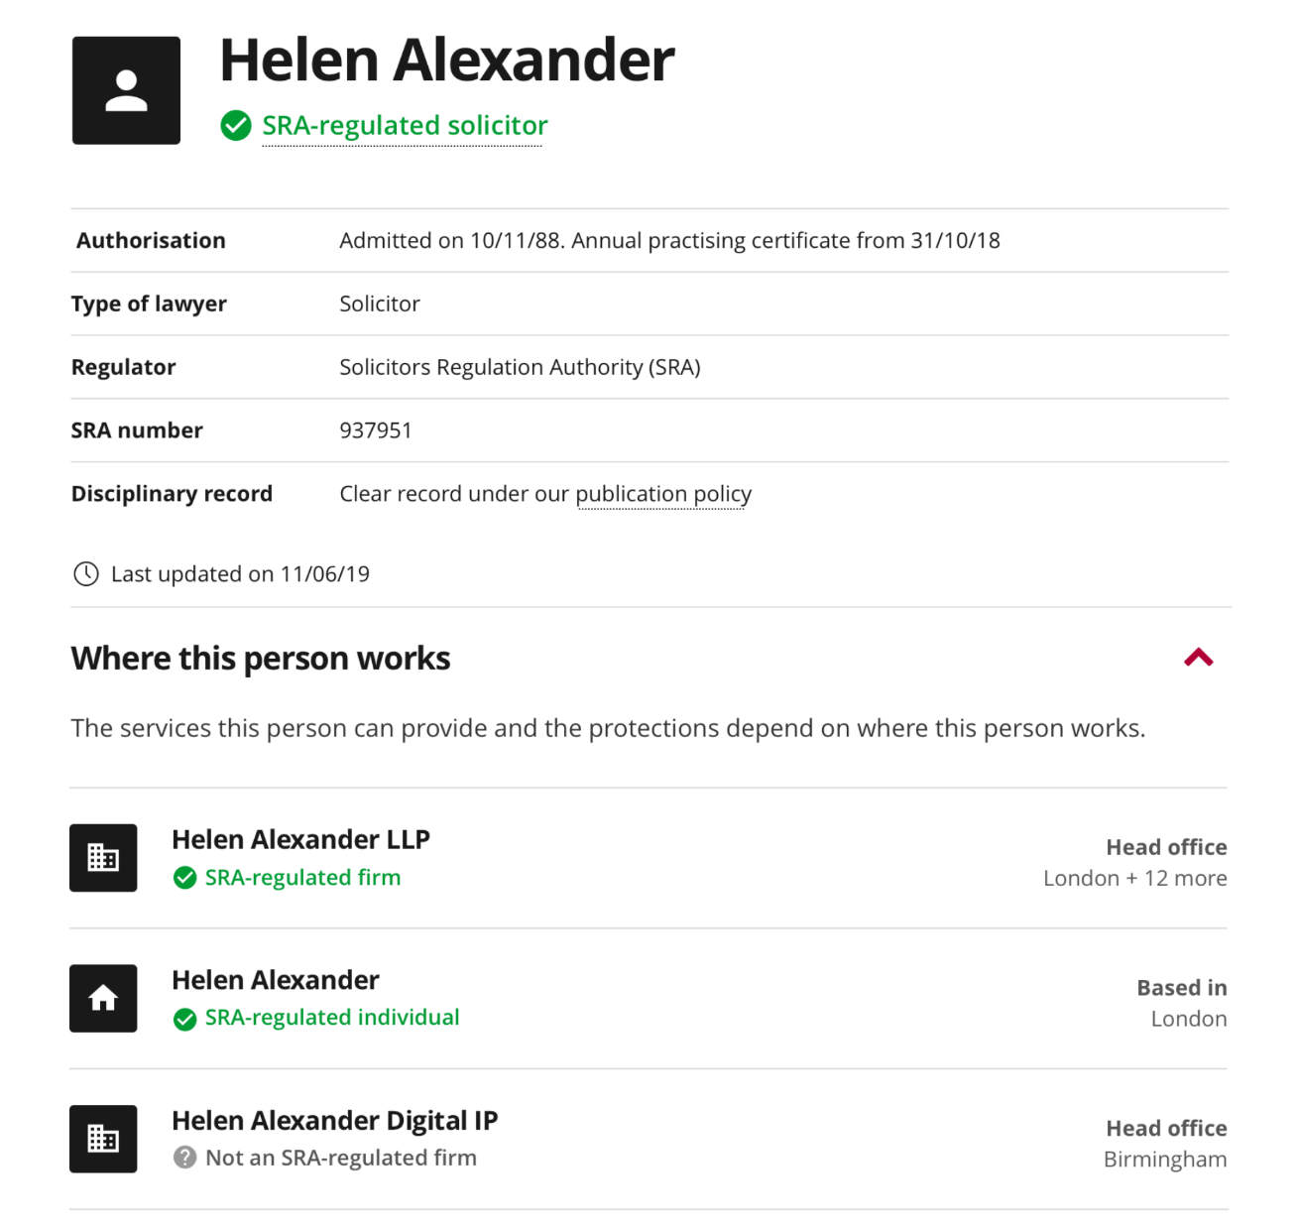

Slide 21
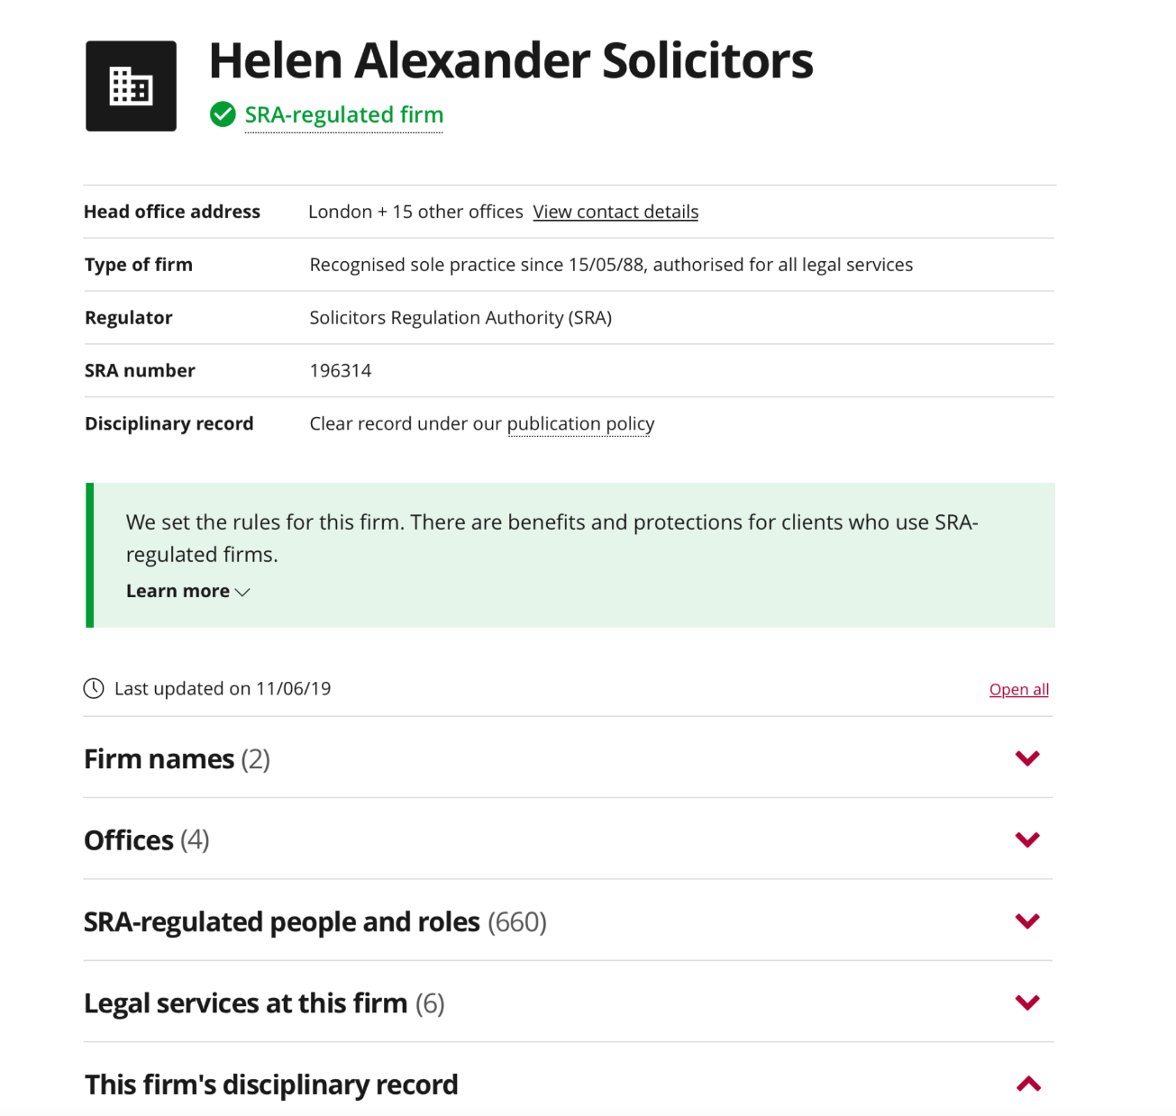

Slide 22
What next…
Make sure your information in mySRA is up to date!
Notes:
We are due to launch a beta version of register to coincide with the new Standards and Regulations coming into effect.
It’s not the end of that journey – we will want to hear your feedback, and will be developing further functionality.
If you want a look in more detail what it looks like, come to the “Doing Business with us” stand.
In the meantime, the main thing you need to do is check your information on mySRA is up to date.

Slide 23
SQE and continuing competence
Julie Brannan, Director of Education and Training, SRA

Slide 24
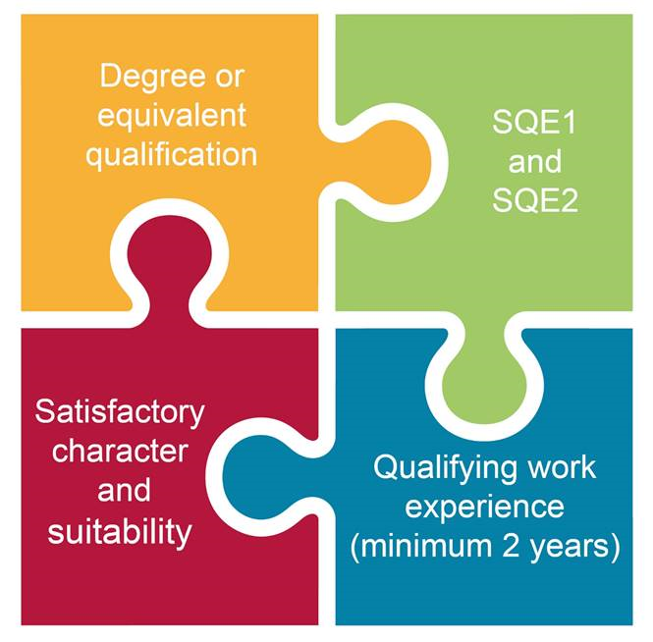
What is the SQE?
Notes:
A reminder as to what the SQE is, with perhaps a particular reminder about what counts as qualifying work experience

Slide 25
SQE: the benefits
Consistent standards
Transparency about training quality
Wider recruitment options
Flexibility for firms and students
Notes:
As Paul has talked through, our reforms are about:
A sharp focus on high standards, while getting rid of lots of prescription
Getting rid of unnecessary bureaucracy that only adds costs onto firms – with a good chance this is then passed onto clients
Making our rules shorter and much easier to navigate
Giving you greater freedom about where and how you can work

Slide 26
Qualifying work experience (QWE)
In law firms, sign off by the COLP (or any other solicitor)
No longer requirement for Training Principal - can keep the role in your firm if you want
You are signing off QWE has been completed - not that the standard has been met (SQE assesses competence)

Slide 27
Where we are…
Notes:
A reminder of where we are in the timeline, with perhaps a brief mention of key decision to be made around if skills are assessed in SQE1 and the types of feedback we’ve been hearing from firms.

Slide 28
Continuing competence
Maintaining high professional standards
Safe to practise by keeping skills and knowledge up to date
But…….flexibility in how this is done
Notes:
To cover off:
Reminder of approach to continuing competence: clear requirement to keep up to date in the StaR
Freedom and flexibility to determine own / firm learning and development
Most people doing it but some aren’t and monitoring annual declarations

Slide 29
Advocacy consultation
Introduction of revised standards for Higher Rights of Audience (HROA)
Creation of single, centralised HROA assessment
More online resources – support advocacy skills
Notes:
Separately, we are consulting on our approach to assuring ourselves of high standards in advocacy…Given an area of law where people’s freedom and livelihood at stake.
Lots of solicitors do great work in a very challenging area of the law, but there are some concerns about whether standards are maintained a cross the board.
Our proposals for change in this area include:
the introduction of revised standards for the Higher Rights of Audience qualification
the creation of a single, centralised Higher Rights of Audience assessment
the development of more online resources to help solicitors maintain and develop their advocacy skills.
But we really want to hear your views, particularly if you work in this area of the law. The consultation closes in two weeks time.

