Slide 1
SQE final design: what the SQE tests?
Julie Brannan, Director of Education and Training

Slide 2
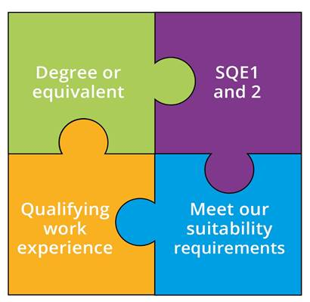
What is the SQE?
A single rigorous assessment
Everyone will meet the same high standards in a consistent way
We will no longer specify routes to admission as a solicitor
Introduced autumn 2021
Notes:
SQE 2 only after passing SQE 1

Slide 3
SQE1
Functioning Legal Knowledge Assessments
Two 180-question examinations - 10 hours in total
FLK - test ability to identify legal principles and apply them to client problems and transactions
Unflagged ethics questions throughout

Slide 4
SQE1
Functioning Legal Knowledge Assessments
FLK1
FLK2
Business Law and Practice
Dispute Resolution
Contract
Tort
Legal System of England and Wales
Public Law
Legal Services
Property Law and Practice
Wills and Admin of Estates
Solicitors Accounts
Land Law
Trust
Criminal Law and Practice

Slide 5
SQE2
Practical legal skills assessments
+
16 written and oral tests - 14 hours in total
Simulating tasks carried out by a solicitor in practice
Tests practical legal skills and functioning legal knowledge equally
Unflagged ethics questions throughout

Slide 6
SQE2
Practical legal skills assessments
Six skills assessed
Client interviewing and attendance note
Advocacy
Case and matter analysis
Legal research
Legal writing
Legal drafting
Across five contexts
Criminal Litigation
Dispute Resolution
Property Practice
Wills and Intestacy, Probate Administration and Practice
Business organisation rules and procedures

Slide 7
Where is the detail?
SQE1 Assessment Specification
SQE1 sample questions
SQE2 Assessment Specification
SQE2 sample questions – coming this autumn
Visit sra.org.uk/sqe

Slide 8
Keep in touch
Monthly SQE Update
bulletin
Send your queries to sqe@sra.org.uk
Join our SQE LinkedIn group
SQE resources sra.org.uk/sqe

