Slide 1
Anti-money laundering – what you need to know
Liz Rosser, Executive Director of Resources, SRA, (Chair)
Zoe Allen-Robinson, AML Proactive Supervision Manager, SRA
Colette Best, Director of Anti-money Laundering, SRA
Sue Hatton, Managing Director, Pickerings Solicitors

Slide 2
To cover
Themes we are seeing
Focus for the year ahead
Findings from proactive supervision
Trends in enforcement
Law firm perspective
Q&A
Notes:
Thank you Liz,
Our report on findings from the last financial year, has recently been published, and I am going to focus on the key themes we are seeing, with a particular focus on the improvements compared with the previous reporting year.
I will then look forward and talk about the focus of the team for the year ahead, and hand over to Zoe who will talk in a bit more detail about what we have seen, and the areas that need improvement. She will share some practical suggestions as she covers the findings.
We will then consider the enforcement action taken in this place, and detail some of our decisions in this area, in the hope of assisting firms in avoiding systemic aml issues in your businesses.
Then we are delighted to have Sue Hatton, who will provide her perspective on compliance with AML regime, having received an inspection during the last reporting period, and share her key take aways and practical tips.
There will then be a chance to ask questions to the panel, we will cover off questions received in advanced, but do get involved if there is something you would like us to cover.
Option to speak to staff on the stand

Slide 3
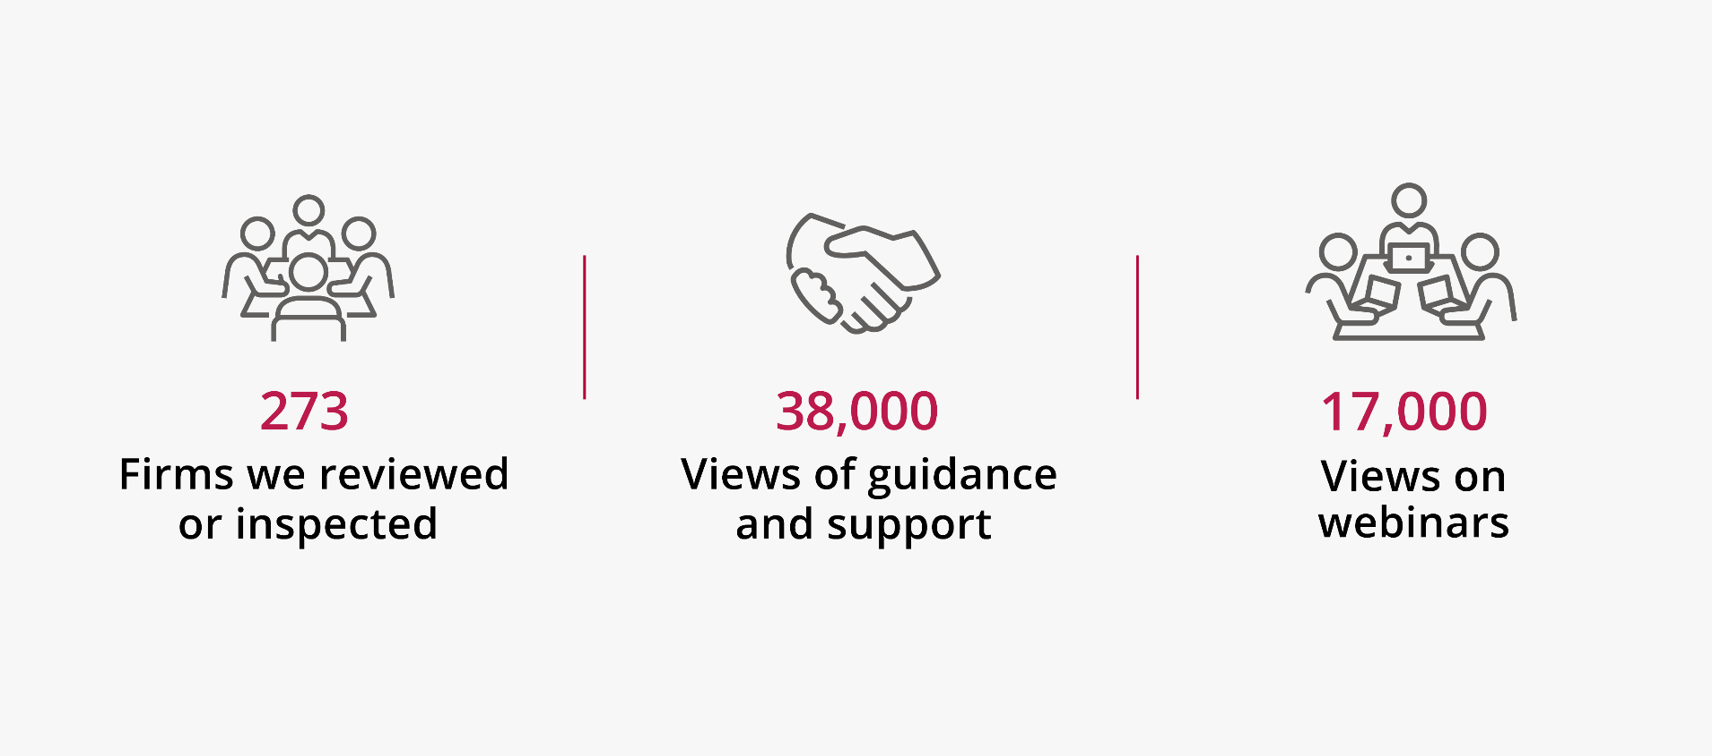
What did we do?
Notes:
All this covered in annual report – more detail on themes and areas for improvement
thank you to all the firms involved in our inspections and desk-based reviews over the last reporting year. While we have a responsibility to undertake this work, and firms have a duty to co-operate, we do appreciate the disruption this can cause, and flexibility required. I’m pleased to report that the majority of firms continue to find these exercises useful and in particular, the feedback they receive and assistance in improving their controls if necessary.
126 rolling inspections
13 FI
25 thematic
109 DBRs
LSAG guidance been updated, waiting for HMT approval. Includes guidance on PF
In the last year have published guidance for MLROs/MLCOs
Guidance on who the regs apply to
Lots of webinars online

Slide 4
Key themes
Improvements in the sector:
Quality of firm wide risk assessments
Suspicious Activity Reports
Notes:
FWRAs
We are pleased to see an improvement in FWRAs in this reporting period compared with previous years. This reflects the thought, effort and time that many firms put into these documents.
In some of the best examples we saw it was clear the person undertaking the FWRA had worked closely with various teams and partners across the business to assess the risks. On more than one occasion, we saw firms had undertaken separate AML risk assessments for separate business areas/offices within their practice.
The advantage of this was that all areas of the business were feeding into the FWRA. It also helped to demonstrate a risk-based approach, as something which would be low risk in one business area may be considered high risk elsewhere
Although we saw a reduction, there are still a very significant proportion of firms with FWRAs that are not compliant, so we would urge firms to review and update this key document.
There were several themes which featured within the non-compliant FWRAs. These include:
Several firms only put in place a FWRA after we asked to see it. This is despite each of these firms confirming it had a compliant FWRA in place in January 2021.
Providing an alternative document, such as an AML policy.
Providing an operational risk assessment, which looks at business risks as a whole, not AML risks.
Using a template but not completing it correctly (for example, using a checklist or not including enough detail).
Failing to consider all services the firm provides.
Many firms failed to expand on the risks identified, for example, we saw firms stating they often operated in high-risk jurisdictions but not setting out and assessing the applicable jurisdictions.
Many documents focused on what the firm does not do (for example, setting out that the firm does not offer trust formation services or act for PEPs), instead of focusing on the AML risks present in its day-to-day business
Note: new requirement proliferation financing RA reg 18A
Can we point to any helpful information here, or flag guidance will be coming?
SARs
Where we conducted an inspection onsite during the reporting period we have also reviewed a sample of SARs submitted by the firm to the NCA over the past two years.
Our findings after one year have not been indicative of significant quality issues in SARs submitted by firms.
Most of the SARs we reviewed were written in a comprehensible manner. They clearly identified what the reporter thought to be the proceeds of crime and describing the legal work involved, the parties involved and the transaction.
Room for improvement:
Our most consistent finding is that firms did not include glossary codes in their SAR narratives as recommended by the NCA. The inclusion of glossary codes helps triage SARs to the correct area of law enforcement.
A quarter of DAML SARs firms did not describe the criminal act that they were seeking a defence against. This demonstrates a lack of understanding around the purpose of DAML SARs.
Firms also missed out phone number and email address details in around a quarter of submissions. This information is useful to law enforcement in investigating crime. Where available firms should include this information when submitting SARs.
In autumn 2021 we broadcast a webinar with the NCA to help firms understand when they should report concerns to us and how to submit a good quality SAR.

Slide 5
Focus of the year ahead
Client and matter risk assessments
On-going proactive sanctions compliance
Source of funds
Notes:
Client and matter risk assessments:
Flowing from FWRA, client/matter risk assessments prevent money laundering by making sure firms consider the risks posed by each, and whether firms can perform the correct level of CDD to mitigate those risks. Client and matter risk assessments are required under regulation 28(12) and 28(13).
We had concerns about whether firms were undertaking client/matter risk assessments during the reporting period, as well as the quality of those assessments and whether they led to risk-based CDD.
Zoe is going to talk more about our findings in this area, but we found significant numbers of ineffective matter risk assessments, or files where these were not present at all.
Failure to appropriately assess a client and their matter, is not only a significant breach of the regulations that could result in action from us, but if not appropriately rated could lead to insufficient due diligence and facilitation of money laundering.
Due to the importance of this provision, and poor compliance in this area, we are looking to do a thematic next year.
Sanctions compliance
May want to cross refer to your other main stage session
The pace and complexity of the changes to the sanctions regime over the past year have presented challenges for some firms.
This is an important regime and the consequences of non-compliance are high because of the strict liability enforcement by the Office of Financial Sanctions Implementation. Firms must, therefore, make sure they are fully compliant at all times.
For most firms this comes down to:
correctly identifying designated persons
avoiding providing them with prohibited services without proper licensing from the Office of Financial Sanctions Implementation
making sure all reporting obligations are fulfilled
As well as setting out our expectations of firms, the guidance we will publish in the coming year will help firms to comply with these obligations
We are increasing the scope of our work in the team and this will include a rolling programme of proactive work around compliance with the sanctions regime.
[we have already undertaken a screening exercise with a selection of firms with exposure to the Russian market, and then a wider thematic piece speaking with firms that undertake work in the sanctions space, such as advising on this area, trade, shipping etc]
The work we do in this area will not just be with firms in scope of the AML regulations, but cover the whole sector, and firms will need to consider the controls they have in place to prevent breaches of the regime and assisting designated persons.
Source of funds
While the latest LSAG guidance provides significantly more information on this and supervisors expectations, there is still a challenge for firms around when are these checks necessary and a misunderstanding on what firms should be checking and evidencing.
We recognize this is a difficult area and where the risk based approach is essential. We see some firms collecting documents such as bank statements, but it clear they are not reading them or asking appropriate questions where the statements show very low income and lump payments with unclear sources.

Slide 6
Proactive update
Client and matter risk assessments
Policies, controls and procedures
Independent audit
Enforcement and case studies

Slide 7
Client and matter risk assessments
42% of client/matter risk assessments reviewed were ineffective
30% did not show clearly when EDD was necessary, including where mandated under the regulations
20% did not reflect the firm’s firm wide risk assessment
Notes:
During the reporting period we reviewed 1,325 files. Of these, 20% did not contain a client/matter risk assessment, as necessary under the regulations. Where firms failed to undertake client/matter risk assessments, they were referred for an investigation. There were a few exceptions, such as where EDD was being carried out. Other key findings were:
20% of client/matter risk assessments did not reflect the firm’s FWRA
30% of client/matter risk assessments did not clearly show when EDD was necessary
42% of client/matter risk assessments reviewed were ineffective
Again, this is an area where improvement is needed and we provide insight below that should help firms to take the necessary steps.
Poor practice
In some cases, firms had a template matter risk assessment form, but this was not being completed correctly, or even used at all.
Many of the forms we saw were very basic and tick box in nature, where fee earners only had to mark whether a file was high risk, medium risk, or low risk. Often, these forms did not feature any commentary or justification where the fee earner could input how they had arrived at the risk level.
Similarly, many forms we looked at failed to set out high-risk factors, which fee earners need to consider when assessing the level of risk with the client or matter. These forms also failed to notify the fee earner when EDD was required. This is concerning, as matters subject to EDD are typically the highest risk.
Many matter risk assessment forms we looked at did not reflect their FWRA. For example, one firm considered all cash purchases in property matters to be considered high risk in the FWRA. When we reviewed the matter risk assessment, this was assessed to be low risk by the fee earner.
We also reviewed a number of risk assessment forms which assessed the wider risk to the business as a whole. For example, reputational risk and whether the client had the ability to pay fees, as opposed to the AML risk. These forms would not constitute a client or matter risk assessment as needed under the regulations.
Good practice - best examples
Some of the best examples we saw were where the matter risk assessment form set out factors which fee earners must consider when making an assessment of client or matter risk.
We also saw some good examples where firms used different matter risk assessment templates, depending on the type of work being carried out. For example, whether the matter was transactional or non-transactional. These templates contained guidance for fee earners around the various risks that could be present.
One firm adopted a client or matter risk assessment form that set out various risk factors which must be considered by fee earners. Each of these factors provided a risk weighting. Where a certain risk threshold was met the fee earners had to gain approval from the MLCO to proceed with the matter.

Slide 8
Policies, controls and procedures
We reviewed AML policies for 224 firms
More than half of the policies we reviewed needed improving (58%)
High risk third countries & high risk jurisdictions
Process for ensuring compliance with the sanction's regime

Slide 9
Independent Audit
Of the 143 firms we inspected, 51% had not undertaken an independent audit
Of these, we deemed that 45% should have had one
Majority due to size of firm
Also consider multiple offices
Nature of work, is it high risk

Slide 10
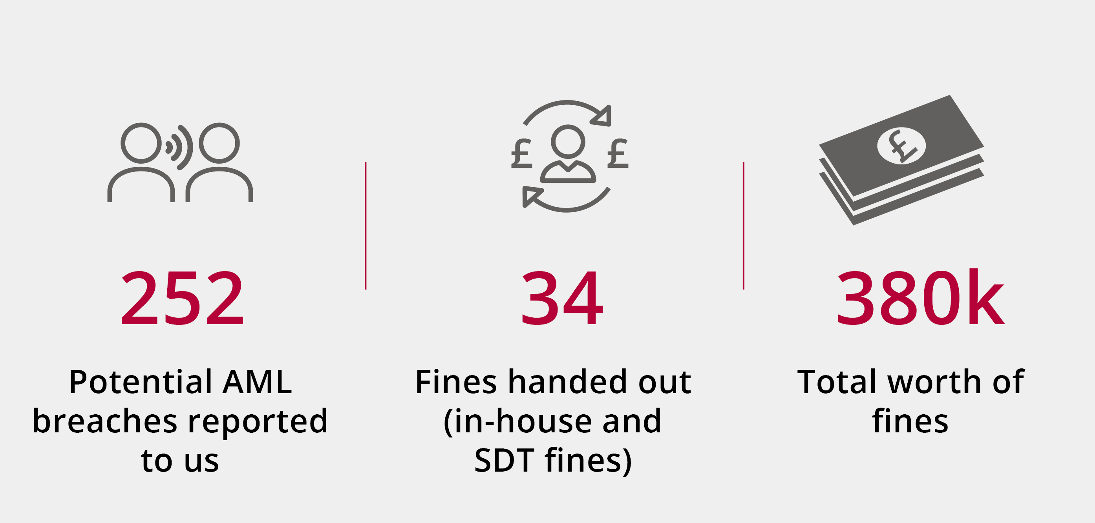
Enforcement
We continue to see a high number of reports
Notes:
In 2021/22 there were 252 money laundering-related reports with 393 reasons attached. Often, reports have more than one suspected breach that need investigating and these can change during the life of an investigation as we get more information.
Specific matter reason:
Failure to carry out/complete initial CDD-49
Failure to carry out a money laundering risk assessment-40
Failure to carry out a source of funds check-39
Failure to identify client-28
Failure to have proper AML procedures-26
In total, there were 51 enforcement outcomes in relation to money laundering.
In around half of the cases the most common area for breaches related to firms failing to respond to us and failing to provide declarations about AML compliance. These amounted to 26 fines where firms failed to declare to us whether they had a compliant firm-wide risk assessment in place.
Of the remaining outcomes the majority related to the buying and selling of property and poor customer due diligence (CDD). These concerned inadequate identification and verification of clients (both individual and corporate) and source of funds checks.
Understanding the source of funds to be used in a transaction is a fundamental part of the risk-based approach. If you are clear around the legitimacy of the source of funds, the risk of money laundering is greatly reduced. While we have seen a slight improvement, firms need to do more in this area.Other issues we identified were:
Failures to apply enhanced customer due diligence (EDD).
Failure to have a firm-wide risk assessments (FWRA) or having a FWRA that was inadequate.
Poor policies, controls and procedures.
Failure to notify us of the appointments of money laundering reporting and compliance officers or seeking approval as a manager (BOOM).
Failing to have sufficient regard for issued warning notices and red flag indicators (as highlighted in a FATF report) in transactions.
We have identified three key themes that we believe contributed to these breaches:
Lack of understanding of the importance of our role as a professional body supervisor and complying with data requests from us.
Inadequate supervision or training of fee earners on firms’ policies, controls and procedures.
Having poor policies, controls and procedures, such as poor processes which allow the receipt of funds from clients when no checks had been carried out. We expect to see an increase in the number of sanctions for such failings. This is on top of the historic common themes of failings relating to adequacy of CDD measures on individual transactions
DRAW OUT CASE STUDIES

Slide 11
Enforcement
Similar themes for reports and outcomes
Inadequate Customer Due Diligence
Failure to do necessary source of funds checks
Failure to carry out a firm wide risk assessment and cooperate with regulator
Notes:
In 2021/22 there were 252 money laundering-related reports with 393 reasons attached. Often, reports have more than one suspected breach that need investigating and these can change during the life of an investigation as we get more information.
Specific matter reason:
Failure to carry out/complete initial CDD-49
Failure to carry out a money laundering risk assessment-40
Failure to carry out a source of funds check-39
Failure to identify client-28
Failure to have proper AML procedures-26
In total, there were 51 enforcement outcomes in relation to money laundering.
In around half of the cases the most common area for breaches related to firms failing to respond to us and failing to provide declarations about AML compliance. These amounted to 26 fines where firms failed to declare to us whether they had a compliant firm-wide risk assessment in place.
Of the remaining outcomes the majority related to the buying and selling of property and poor customer due diligence (CDD). These concerned inadequate identification and verification of clients (both individual and corporate) and source of funds checks.
Understanding the source of funds to be used in a transaction is a fundamental part of the risk-based approach. If you are clear around the legitimacy of the source of funds, the risk of money laundering is greatly reduced. While we have seen a slight improvement, firms need to do more in this area.Other issues we identified were:
Failures to apply enhanced customer due diligence (EDD).
Failure to have a firm-wide risk assessments (FWRA) or having a FWRA that was inadequate.
Poor policies, controls and procedures.
Failure to notify us of the appointments of money laundering reporting and compliance officers or seeking approval as a manager (BOOM).
Failing to have sufficient regard for issued warning notices and red flag indicators (as highlighted in a FATF report) in transactions.
We have identified three key themes that we believe contributed to these breaches:
Lack of understanding of the importance of our role as a professional body supervisor and complying with data requests from us.
Inadequate supervision or training of fee earners on firms’ policies, controls and procedures.
Having poor policies, controls and procedures, such as poor processes which allow the receipt of funds from clients when no checks had been carried out. We expect to see an increase in the number of sanctions for such failings. This is on top of the historic common themes of failings relating to adequacy of CDD measures on individual transactions
DRAW OUT CASE STUDIES

Slide 12
Case examples and learnings
Inadequate identity and customer due diligence checks
What is the third-party certifying?
Suitably qualified and true likeness for non face-to-face client
Notes:
As part of our annual report, we have included several case studies to show real life examples of proactive inspection outcomes and enforcement action.
I wish to draw out two and the key learnings, that I hope will be of practical use:
3. Inadequate identity and CDD checks carried out
A firm was acting in the sale of a residential property. The person instructing the firm said they were the genuine owner of the property. The firm never met the client in person and relied on copies of identity documents certified by a third party.
The firm obtained ID documents from the 'client'. The ID documents were certified as being true copies of the original documents, not that there was a likeness to the client. This meant the identity of the client had not been verified. The property was sold and, shortly after, the police contacted the firm to say it was investigating suspicions that the sale was fraudulent.
The firm admitted it had failed to carry out proper CDD We resolved the matter through a regulatory settlement agreement, where firm received a rebuke.
2. Desk based review - referred for lack of client/matter risk assessments
We undertook a desk based review of a large firm. The firm has a dedicated client onboarding team based in the USA. The team were responsible for carrying out client due diligence and conflict checks for the London office.
None of the files we reviewed contained a client/matter risk assessment, as required under regulation 28(12) and 28(13) MLR. The firm explained this did not form part of their existing process.
In addition, several files contained inadequate or missing client due diligence documents. We also identified the firm was not carrying out on-going monitoring on their clients. We identified significant shortcomings in the firm wide risk assessment and policies, controls and procedures.
The firm was referred to our AML investigations team in light of these issues.
While there are many advantages to having a centralised function to carry out your client onboarding checks this does not absolve fee earners of their responsibilities under the regulations. This includes ensuring fee earners continue to monitor clients for any changes in behaviour throughout the course of the relationship.

Slide 13
Case examples and learnings
Lack of client and matter risk assessments
Who is responsible in the firm?
Make sure process in place
Align with your firm wide risk assessment
On-going monitoring
Notes:
As part of our annual report, we have included several case studies to show real life examples of proactive inspection outcomes and enforcement action.
I wish to draw out two and the key learnings, that I hope will be of practical use:
3. Inadequate identity and CDD checks carried out
A firm was acting in the sale of a residential property. The person instructing the firm said they were the genuine owner of the property. The firm never met the client in person and relied on copies of identity documents certified by a third party.
The firm obtained ID documents from the 'client'. The ID documents were certified as being true copies of the original documents, not that there was a likeness to the client. This meant the identity of the client had not been verified. The property was sold and, shortly after, the police contacted the firm to say it was investigating suspicions that the sale was fraudulent.
The firm admitted it had failed to carry out proper CDD We resolved the matter through a regulatory settlement agreement, where firm received a rebuke.
2. Desk based review - referred for lack of client/matter risk assessments
We undertook a desk based review of a large firm. The firm has a dedicated client onboarding team based in the USA. The team were responsible for carrying out client due diligence and conflict checks for the London office.
None of the files we reviewed contained a client/matter risk assessment, as required under regulation 28(12) and 28(13) MLR. The firm explained this did not form part of their existing process.
In addition, several files contained inadequate or missing client due diligence documents. We also identified the firm was not carrying out on-going monitoring on their clients. We identified significant shortcomings in the firm wide risk assessment and policies, controls and procedures.
The firm was referred to our AML investigations team in light of these issues.
While there are many advantages to having a centralised function to carry out your client onboarding checks this does not absolve fee earners of their responsibilities under the regulations. This includes ensuring fee earners continue to monitor clients for any changes in behaviour throughout the course of the relationship.

Slide 14
Sue Hatton MD, MLRO & MLCO Pickerings Solicitors

Slide 15
SRA Inspection - March 2022

Slide 16
Firm wide risk assessment
Training
Case management
Client and matter risk assessment
Timing of due diligence
Source of funds
Ongoing monitoring

